Slide 1
Stock trade, analysis and portfolio management system
Stock trade, analyst simulator and portfolio management
For Windows desktop application
Developed by Quan Xing, Guofeng Wu

Slide 2
Background
Investors
Paper trading
Different investment strategies
The system can
Analyse the history of a stock price
Make an informed decision of stock trade
Manage the investment portfolio

Slide 3
Overview
Analyst Chart
Paper trading
Portfolio management
Watch list

Slide 4
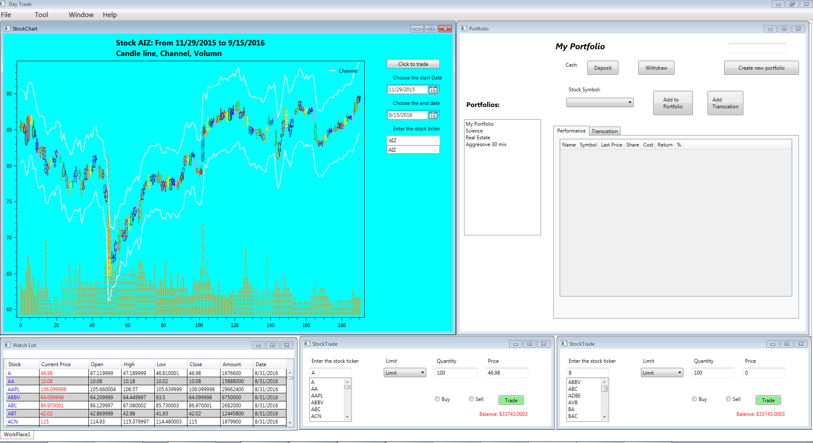
GUI

Slide 5
Problem : Install new library
Try Dynamic Data Display, WPF Toolkit, Xceed Toolkit Plus, DevExpress , Telerik
oxyPlot: 2D plot model from MIT
Tip:
always check the update version before installation
check the key word in entire solution to remove unsuccessful installation

Slide 6
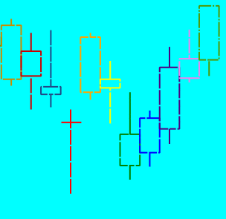
Problem : candle stick, no rectangle in library
Price calculation to generate 10 point with line connection
Tip: Write your code if you are trouble with other library

Slide 7
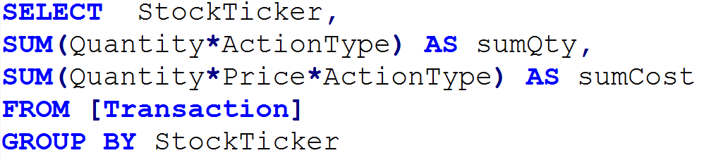
Problem : Query to get quantity and current value by stock ticker without extra data.
wrong: Set buy=true or 1, sell=false or 0
right: Set action buy = 1, sell = -1 ,
none(hold) = 0
Tip: If database can do well for you, do not code

Slide 8
Problem: Get history data for stock and import to Azure database
SP500 company as sample
Daily data using webClient.DownloadFile
http://ichart.finance.yahoo.com
Combine the 500 separate file into one file to fit the table structure
Using import tool of MS Sql Server to Azure database
Local import, script export, run script on Azure
Direct

Slide 9
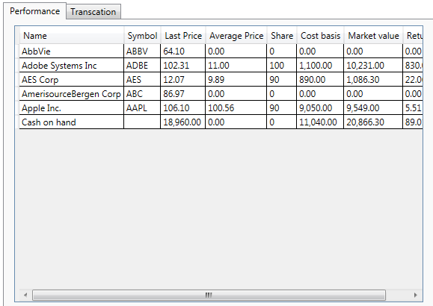
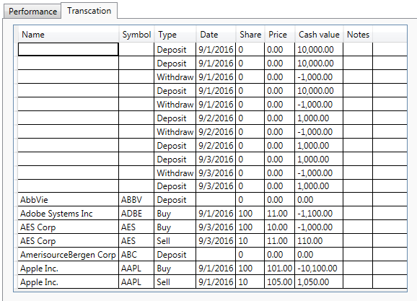
Problem: Show the processed data from database in datagrid
Create a separate class and binding it to datagrid object

Slide 10


Problem: Read and Insert a non nullable data into database

Slide 11
Future work
Live data
Trend Lines on Chart
Layout design
Risk analyst
Delete portfolio and edit portfolio transaction data

Slide 12
Summary
Show candle like stock history chart (daily chart)
Make paper trade
Do investment portfolio management

